Slide 1

%
CRAIGSLIST - ELECTRONICS
CLASSIFICATION AND SPAM DETECTION
MGMT 59000-005: Analyzing Unstructured Data Group Project
AUD Ones Out
Amrit Singh
Deepa Narayanan
Mrinmoy Dalal
Sanchit Agarwal
Vedanti Gulalkari
Anusha Reddy
Notes:
Craigslist is a popular online classified advertisement site that attracts large volumes of traffic. The platform features city and region-specific sites where users can post a range of ads, including job listings, to reach a local audience.

Slide 2




Agenda
Business Problem
Data Analytics
Recommendation
Takeaways
Data Pre-processing
Model Evaluation
Results
Notes:
We’ll be walking you through the following topics during the course of our presentation

Slide 3

Business Problem
Craigslist is a website for viewing and posting local advertisements by connecting nearby people to buy or sell anything. However, it is known for :
Lack of filtering options for quicker search
Reliability issues due to spammers
Duplicates due to retention policy of 30 days
Unorganized and non classified goods
Notes:
About 70% of the craigslist users are based of the US which instigated us to select Chicago as one such cities which had nearly 3000 products for electronics
Craigslist has an average customer rating of 1.17 out of five stars.
Themes dominating the negative reviews include complaints about suspicious user activity and dissatisfaction with customer support.

Slide 4
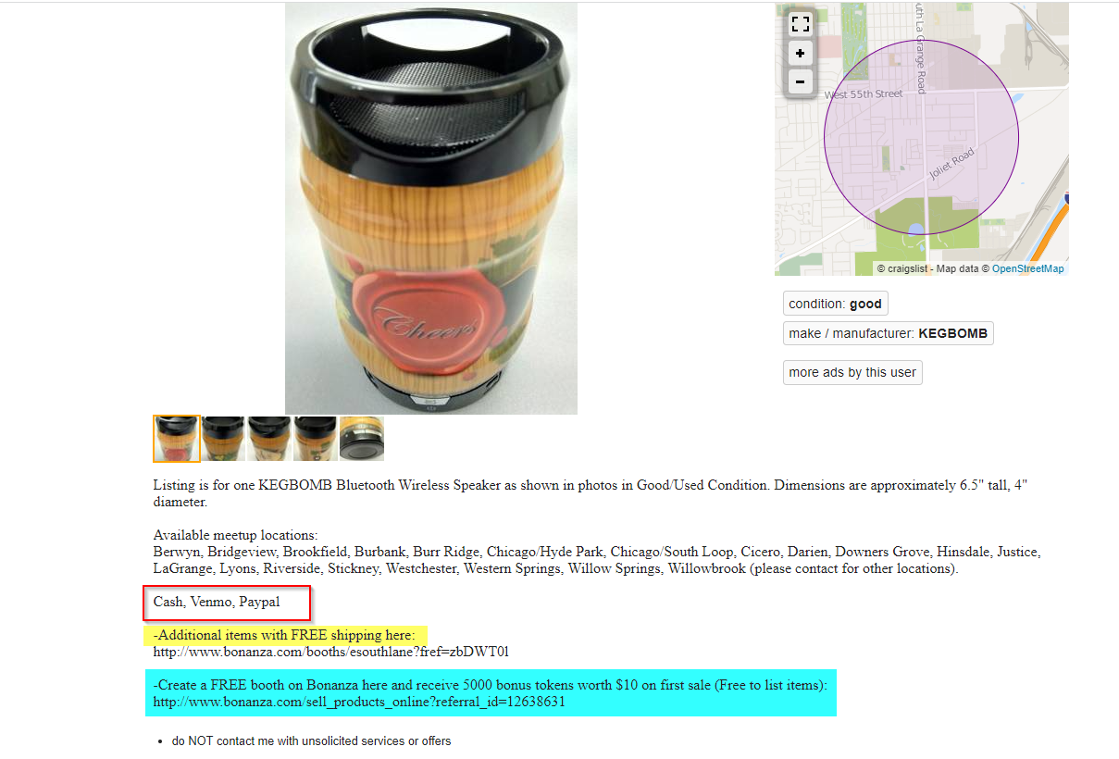




Example
Luring customers for Free Goods
No classification for the electronic device
Beware of items offering Shipping
No authenticity on post to check it is spam or not

Slide 5






Methodology
COLLECTION
ANNOTATION
PRE-PROCESS
MODELING
EVALUATION
Scrape data
Chicago Craigslist
Electronics Section
Manual labelling
Categorization
Spam Identification
Replace Contractions
Non-ASCII
Tokenize
Stopwords
Naïve Bayes
Random Forest
SVM
Neural Network
Logit Regression
Precision
Accuracy
Test Dataset
Notes:
Collection: Iterated through all URLs and programmatically scraped data
Annotation was an important step as it required manual annotations
Spam is not really easy to detect, as each set of reviews has a different set of keywords. We did try to use pretrained models like spam email dataset and spam sms dataset. however, we realised that those models will not be giving us the most precise labelling.

Slide 6



Data Preparation
START
0
1
2
Extract listing link, title & description
Manual & Code Assisted Annotation
Separate listing text, and condition
Remove embedded URLs
3
7
6
5
4
Remove stopwords & punctuation
Remove non-ASCII characters
Tokenize
Convert to lowercase
8
Remove Digits
9
10
11
Ready for Modeling
Lemmatization & Stemming
Convert to Categorical Variables
Split into Train (80) and Test (20)
Represent as TF-IDF vectors
Notes:
BLOCKED TO MOON AND BACK
BATCHES – BEAUTIFUL SOUP
DUPLICATES – 30 DAY WINDOW ON POSTS
TRIED LDA TOPIC MODELING – DIDN’T GET TOPICS - LABELLING THE DATA – MANUAL and PYTHON CODING
NO STRUCTURE TO THE EXTRACT – EXTRACT THE ACTUAL LISTING – ONLY THE DESCRPTION TO BE INCLUDED FOR MODEL
INCLUDED TITLE TO THE DESCRIPTION
CLASSIC STUFF – TOKEN, STOP WORDS, REPLACE CONTRACTIONS AND DIGITS
DID NOT DO STEMMING AND LEMMA SINCE WORDS LIKE PRINTER AND COMPUTER WERE GETTING TRUNCATED
TRIED 30 SPLIT BUT BEST WAS IN 80 20 SPLIT – PROLLY DUE TO ONLY 2800 LISTINGS – MORE DATA
REPRESENT TF-IDF – MIN DOC FREQ 2 WITH NGRAM 1 - 3

Slide 7
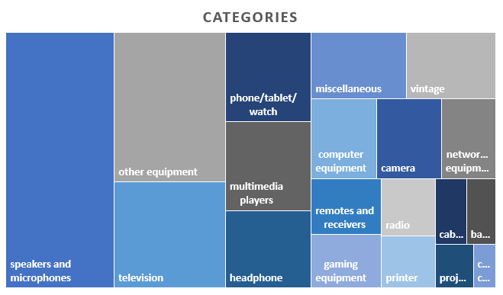
Clustering
Category | Precision | Recall | F1-Score | Support
printer | 1 | 0.79 | 0.88 | 14
phone/tablet/watch | 0.82 | 0.8 | 0.81 | 41
speakers and microphone | 0.76 | 0.84 | 0.8 | 122
headphone | 0.72 | 0.82 | 0.77 | 28
projector | 0.71 | 0.83 | 0.77 | 6
networking equipment | 0.78 | 0.72 | 0.75 | 25
television | 0.7 | 0.79 | 0.74 | 53
camera | 0.71 | 0.74 | 0.72 | 23
multimedia players | 0.69 | 0.76 | 0.72 | 33
gaming equipment | 0.71 | 0.59 | 0.65 | 17
vintage | 0.83 | 0.52 | 0.64 | 29
computer equipment | 0.73 | 0.53 | 0.62 | 30
other equipment | 0.52 | 0.7 | 0.6 | 74
battery | 0.56 | 0.56 | 0.56 | 9
radio | 0.55 | 0.5 | 0.52 | 12
remotes and receivers | 0.45 | 0.36 | 0.4 | 14
miscellaneous | 0.55 | 0.21 | 0.31 | 28
cable | 0.33 | 0.18 | 0.24 | 11
case / cover | 0 | 0 | 0 | 1
Models | Precision | Accuracy
Naïve Bayes | 45% | 39.12%
Random Forest | 57% | 51.05%
Linear SVM | 69% | 69.12%
XG Boost | 67% | 65.09%
KNN | 58% | 50.18%
Neural Network | 50% | 50%
Logistic Regression | 67% | 57.19%
Supervised machine learning algorithm
Used for classification or regression
Kernel trick technique for transformation
Finds an optimal boundary between the possible outputs.
Works best on small datasets
Notes:
FINISHED FIGHTING WITH DATA – STARTED PLAYING WITH MODEL
TRIED MULTIPLE CLASSIFICATION MODELS – NAÏVE BAYES, RANDOM FORES, SVC AND XGBOOST
MODEL PERFORMANCE – ACCURACY – BETTER USER EXPERIENCE – NOT THE END OF THE WORLD IF FEW FINDINGS WERE FALSELY CLASSIFIED
NAÏVE BAYES HAD THE LOWEST ACCURACY – 39%
BEST PERFORMING MODEL WAS SUPPORT VECTOR CLASSIFIER – USED FOR BOTH CLASSIFICATION AND REGRESSION
USED LINEAR KERNEL SINCE ELECTRONICS COULD BE EASILY BUCKETED INTO DISPARATE CATEGORIES
WORKS BEST ON SMALL DATASETS
ACCURATELY ABLE TO PREDICT CATEGORIES SUCH AS PRINTER, PHONES, AUDIO EQUIPMENT
DUE TO THE FACT THAT THE QUALITY OF LISTING WAS BETTER THAN OTHER CATEGORIES

Slide 8
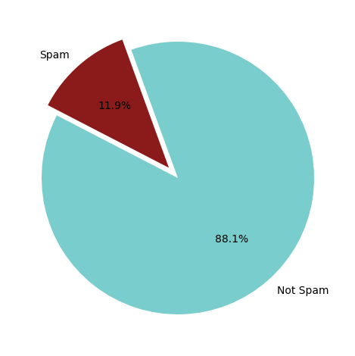
Classification Spam/Ham
Model Comparison
 | Precision |  | Recall |  | Accuracy
 | 0 | 1 | 0 | 1
Naïve Bayes | 91% | 31% | 89% | 37% | 83%
Random Forest- Class weighting (0:1 , 1:8) | 98% | 43% | 84% | 87% | 85%
Linear SVM | 89% | 100% | 100% | 7% | 89%
Polynomial SVM (Degree 3) | 0% | 12% | 0% | 12% | 12%
XG Boost (weighted) | 91% | 73% | 99% | 23% | 90%
Identification of Spam
Not having an authentic QR Code Scanning
Words such as free, voice mailing, credit card details, checks, western union
No price information
Grammar and spelling mistakes
Offering free shipping
Checked the correlation of post description with spam email examples (cosine similarity)
Manual intuition
Precision- Recall compromise!
Notes:
TF- IDF vectorization
RF with class weighting
Tried weighted XG boost

Slide 9
Recommendation and Takeaways
Categories clustered for Electronic devices should be provided as filters.
There should be a structured way for the sellers to sell their products with some mandatory information like price, category
Have validation checks to avoid duplicate posts by tweaking the 30-day retention post for users.
Currently classification has been done via manual annotation. A sophisticated way to classify the images would be to use image captioning, which requires higher computational cost. (GPU: $3.96/hr)

Slide 10
THANK YOU

